Slide 1
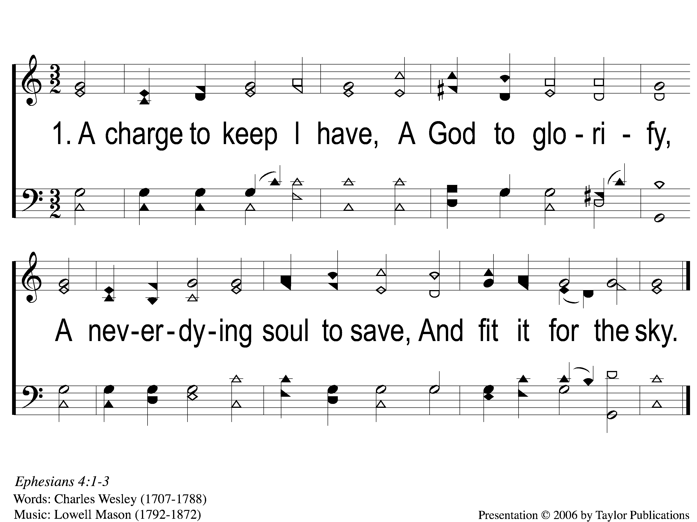
1-1 A Charge to Keep I Have
A Charge To keep I Have
8

Slide 2
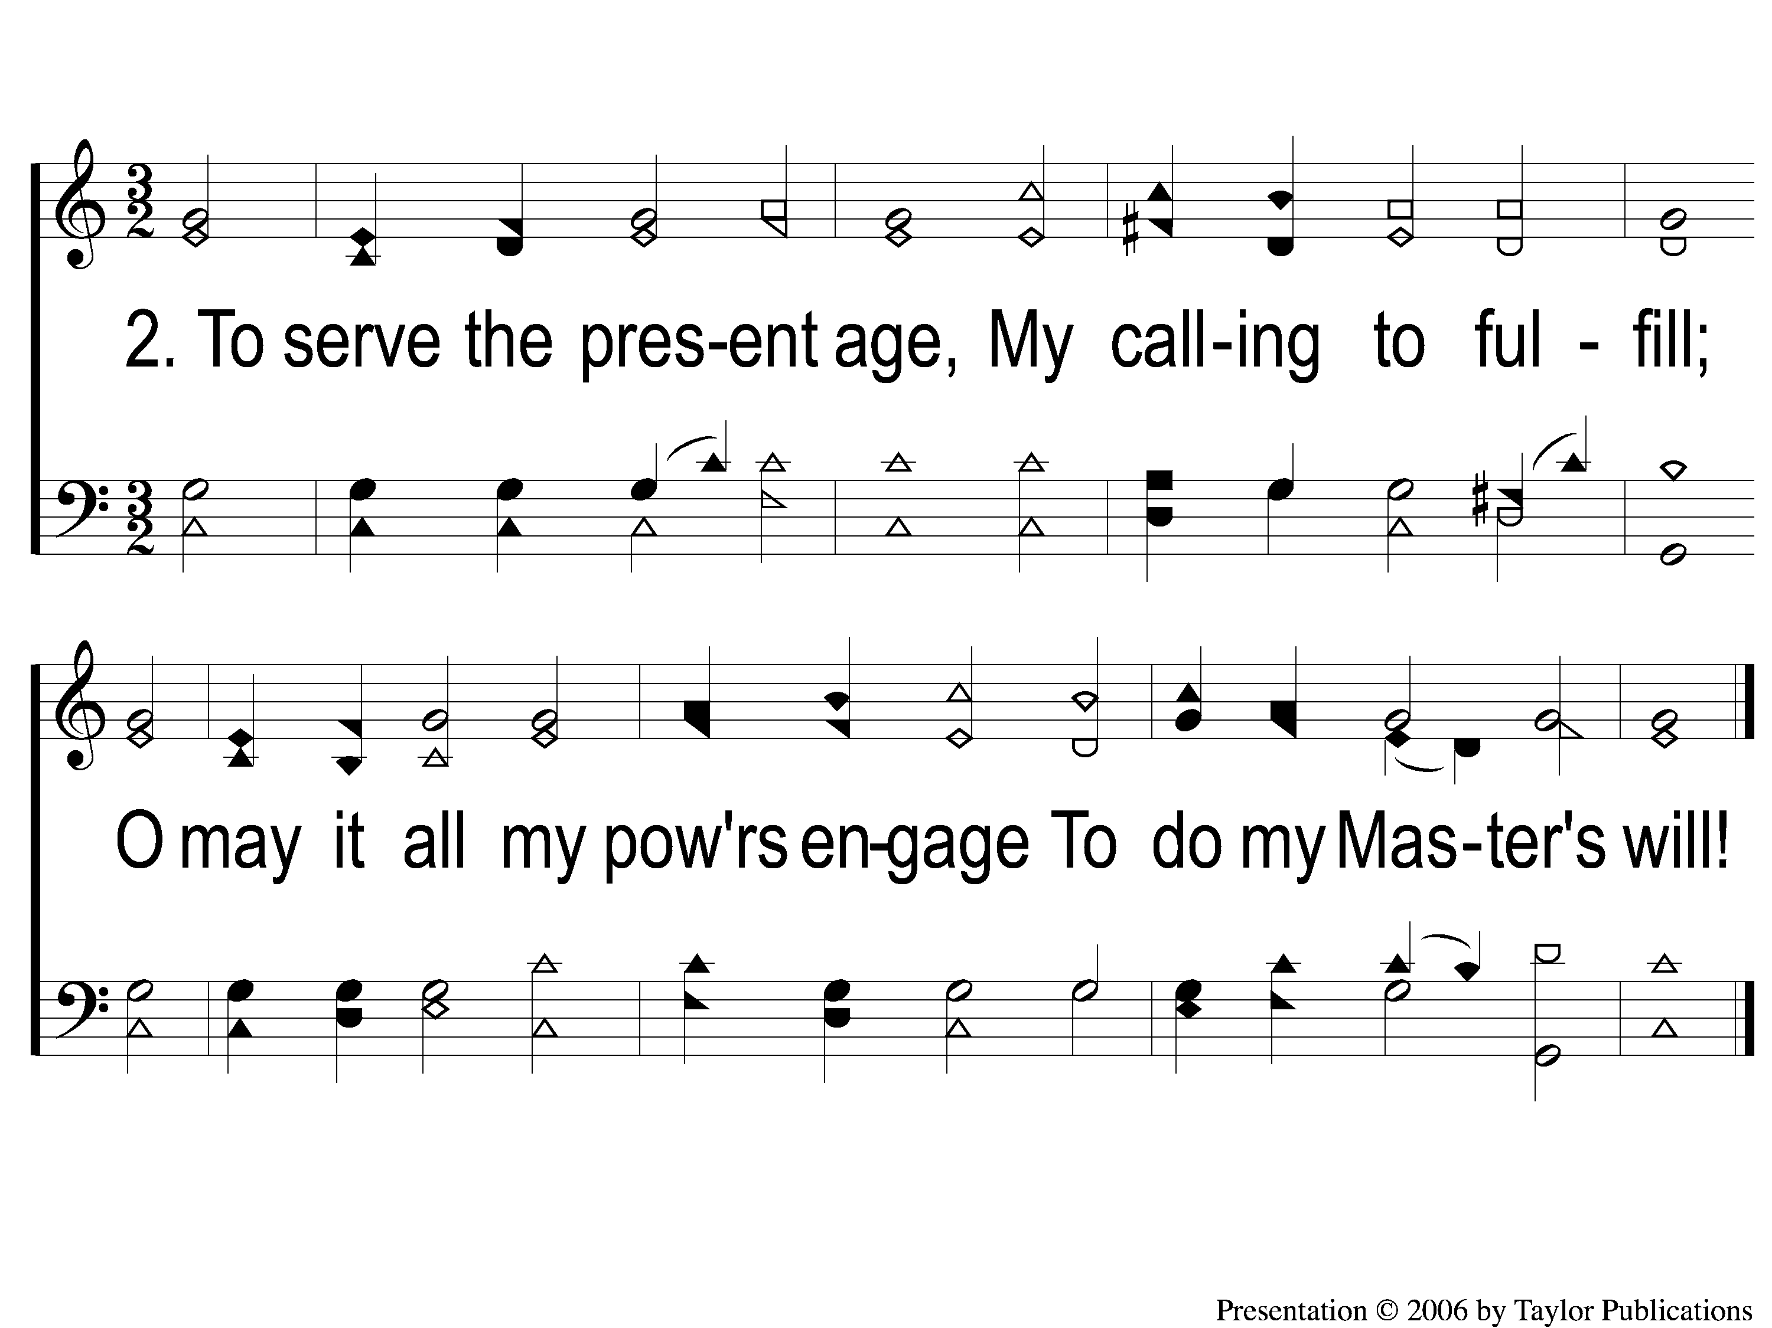
2-1 A Charge to Keep I Have
A Charge To keep I Have
8

Slide 3
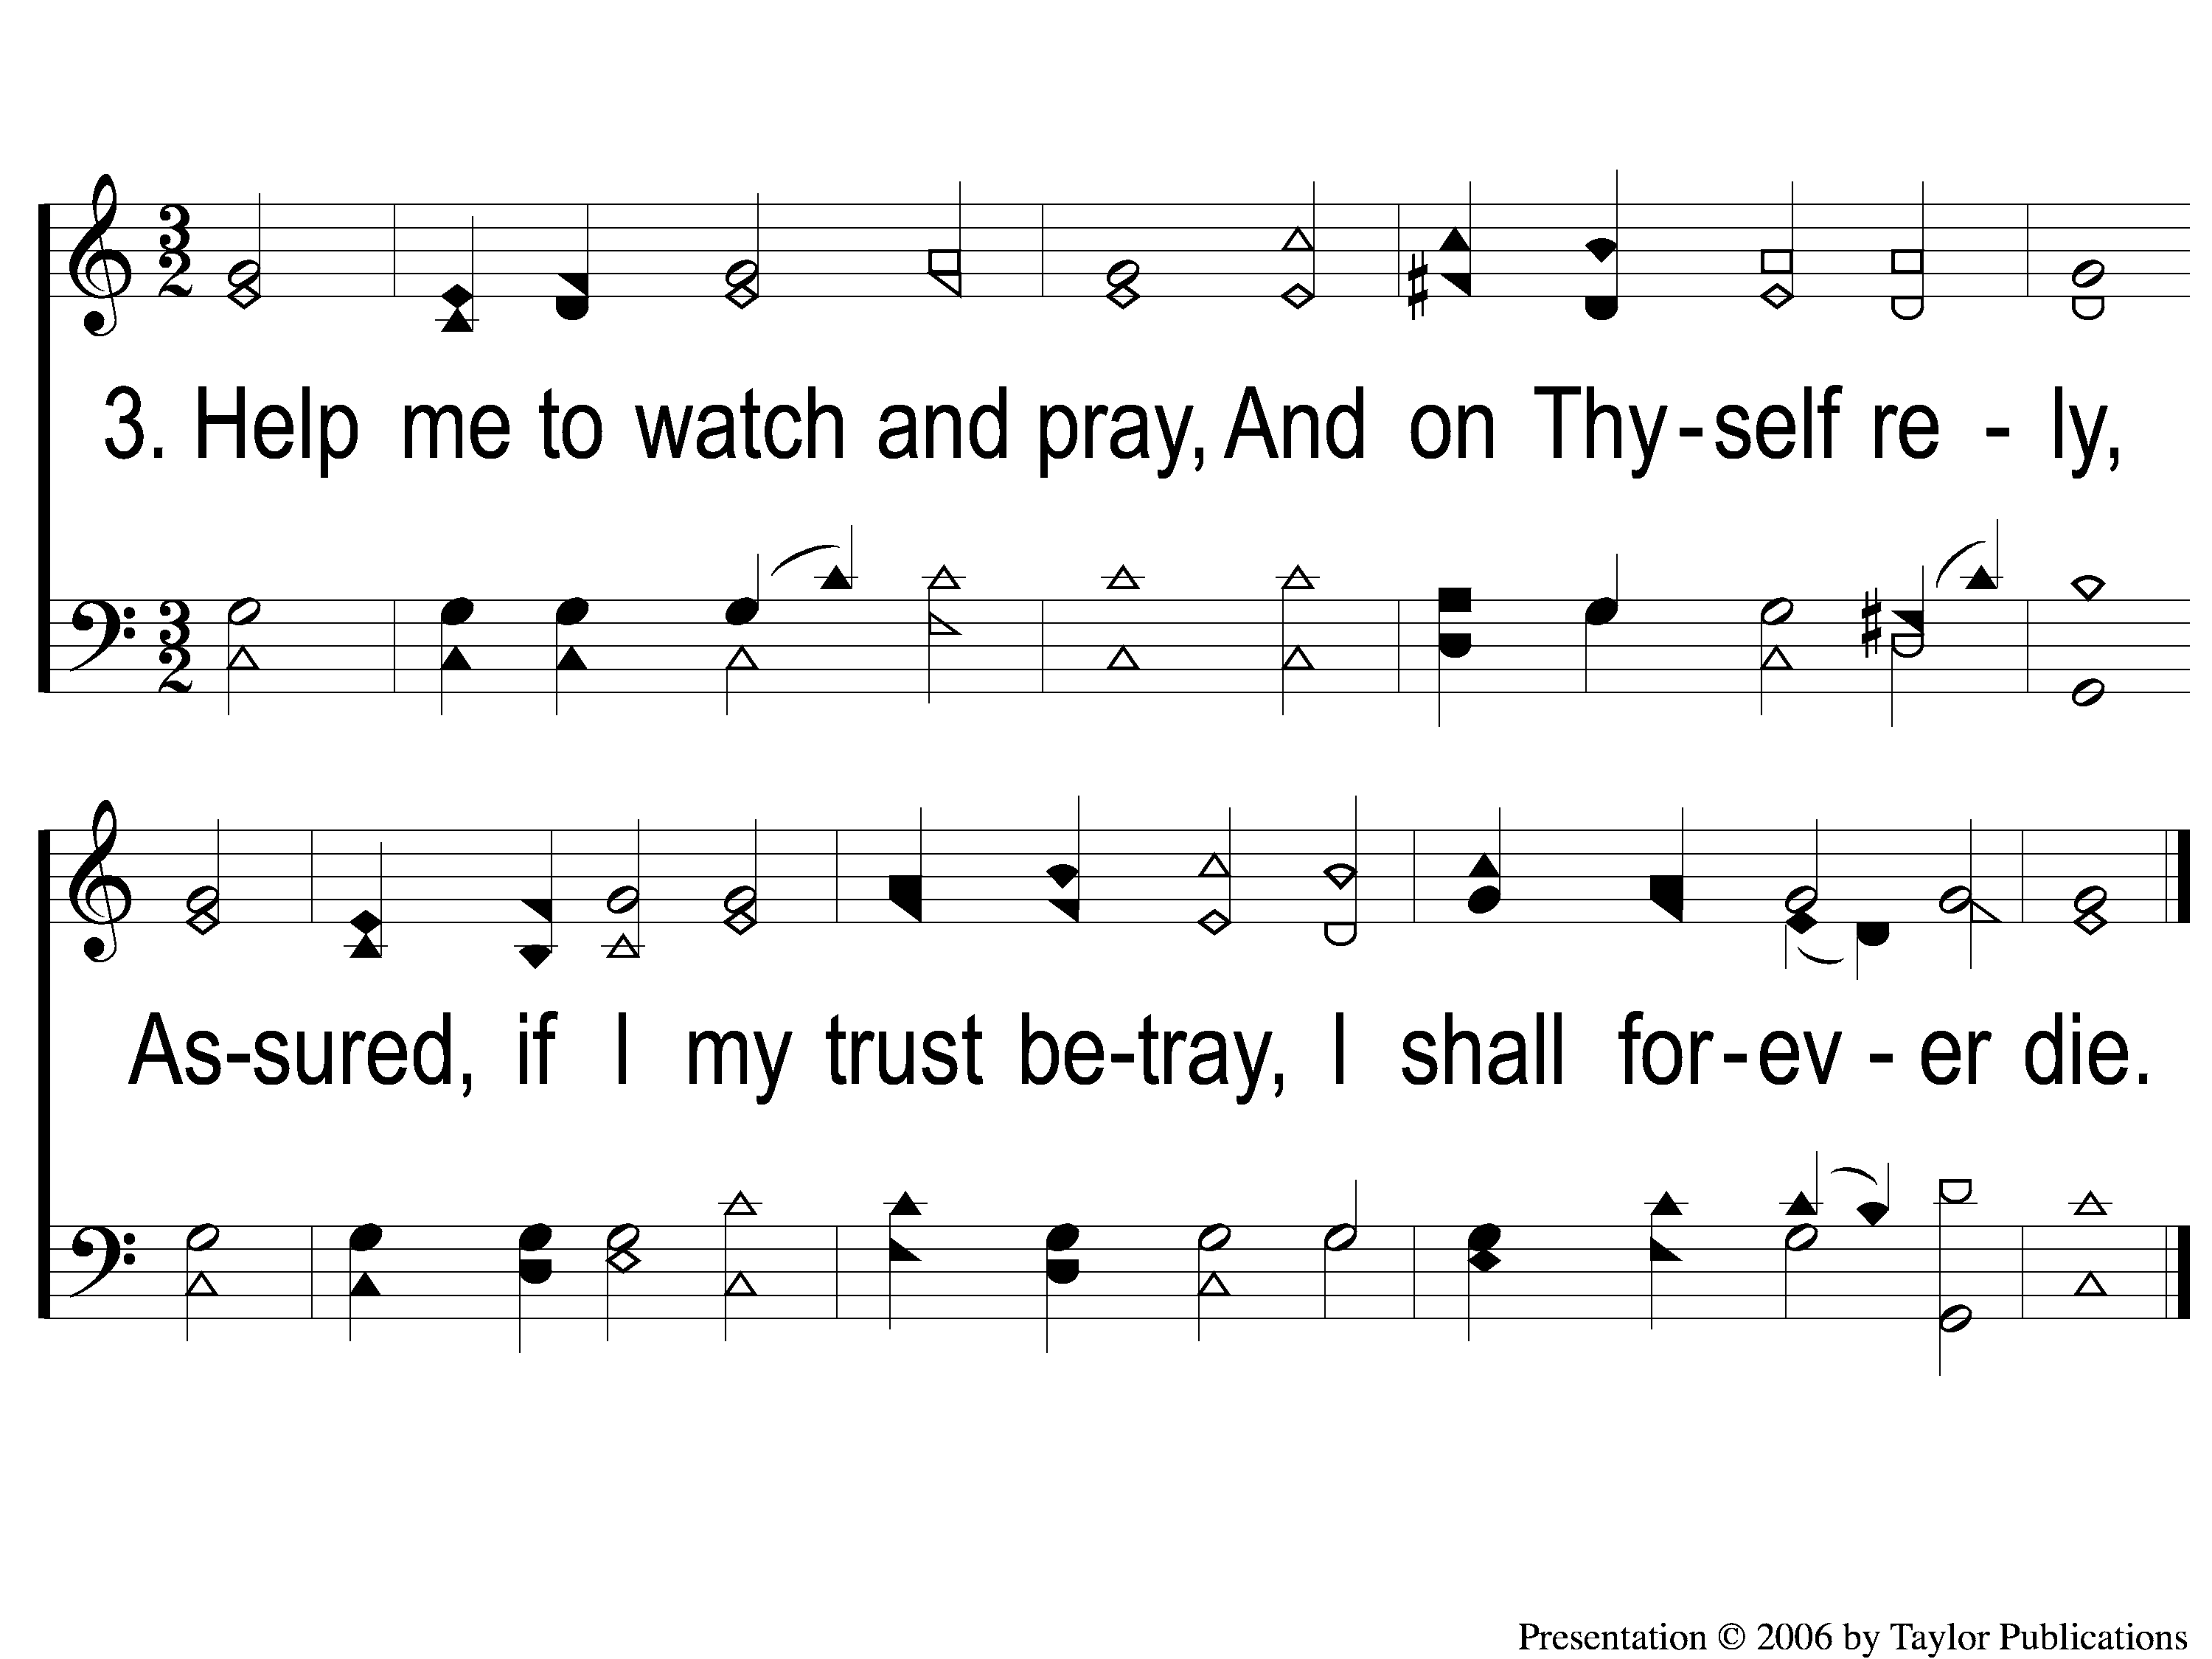
3-1 A Charge to Keep I Have
A Charge To keep I Have
8

